Slide 1

Trends in Real-Time Embedded Software Development:
Technologies and Processes
Bruce Powel Douglass, Ph.D.
Chief Evangelist
I-Logix, Inc.
www.ilogix.com
bpd@ilogix.com

Slide 2
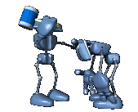
Technologies

Slide 3
Visual Modeling with UML
Object
Diagrams
Class
Diagrams
Use Case
Diagrams
Deployment
Diagrams
Structural
Diagrams
Visual Modeling
Functional
Diagrams
Component
Diagrams
Statecharts
Diagrams
Behavioral
Diagrams
Collaboration
Diagrams
Sequence
Diagrams
Activity chart
Diagrams

Slide 4
Platform-Independent Models
Intellectual property (IP) is expensive to create and maintain yet crucial
Most embedded software must be recreated when moving to a new platform or environment
  New Middleware
  New source code languages
  New Operating Systems
  New Hardware
Further, these systems must interface with massive legacy systems

Slide 5
Platform-Independent Models
The use of PIMs allows systems to be created that can easily be ported to new technologies, infrastructures and frameworks reusing corporate IP:
  Application Domain Models
  Platform-Independent Architectures (PIAs)
Intellectual property is then managed in a format more abstract and reusable than source code

Slide 6
Constructing PIMs
PIMs are often constructed as layered systems in which a more abstract layer is realized by a more concrete layer
Platform-Independent
Application
Application IP
Platform-Independent
Framework
Application domain IP
OS-Dependent Adapter
OS Specific Plug in
OS-independent connection services
Middleware
RTOS
Platform isolation services
Hardware
Platform-specific

Slide 7

PIMs In Practice
Model entry
Code generation
Source code
Compiler and Linker
Compilation
Platform-Independent
Application
Model-Entry (UML diagrams)
Model Compiler
Platform-Independent
Framework
Model animation and monitoring
Integrated Test Environment
Application stimulation during test and debug
OS-Dependent Adapter
Model-level
Execution Tools
Middleware
Model Monitor
RTOS
Desktop Modeling Environment
Hardware
Application on Target
Application execution behavior

Slide 8
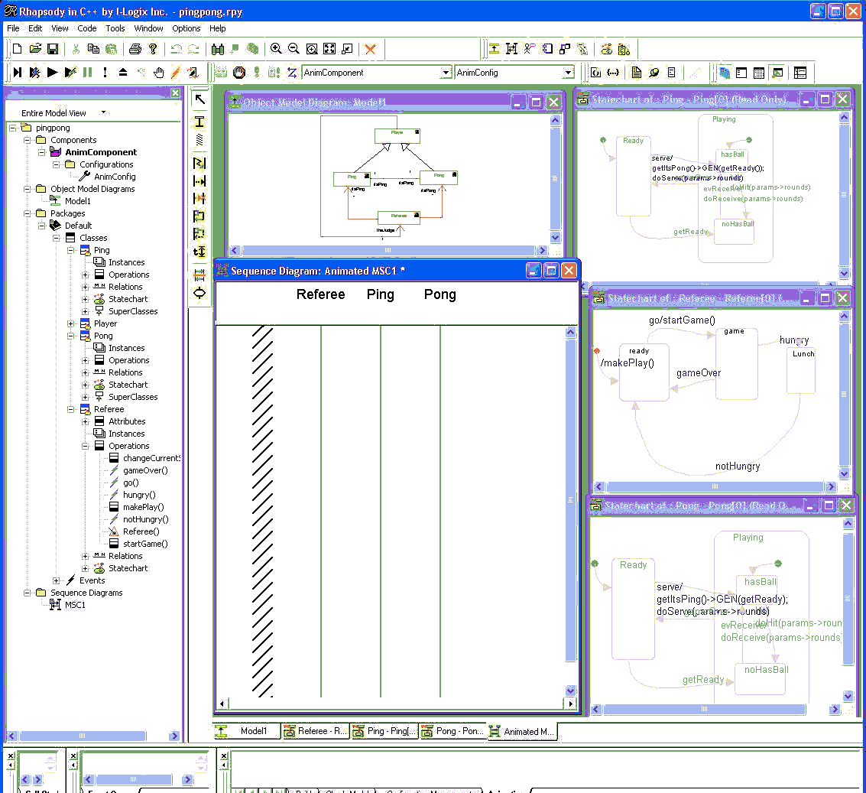
Executable Models
How do you know it’s right????
You can’t test what you can’t execute
Rapid execution allows you to incrementally construct your system and remove bugs easily and quickly
You want to execute applications at the design level rather than at the code level

Slide 9
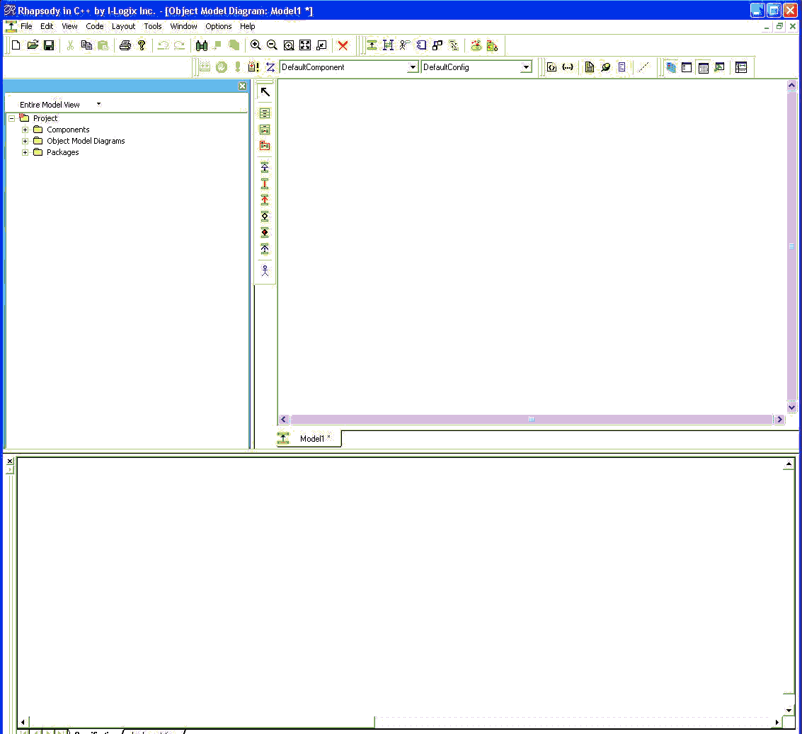
Model-Code Associativity
When code deviates from your visual models, what do you do?
The model is a coherent set of integrated abstractions that represents your system
Solution: think of the code as one of several possible views of the model
Tools allow you to manage the diagrams and code as views dynamically linked to the underlying model
  Modify in one view, all the other relevant views are updated automatically

Slide 10
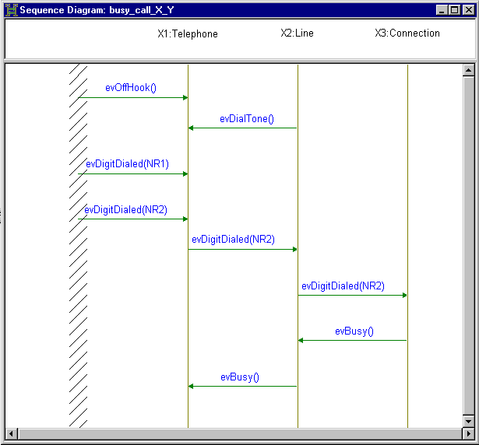
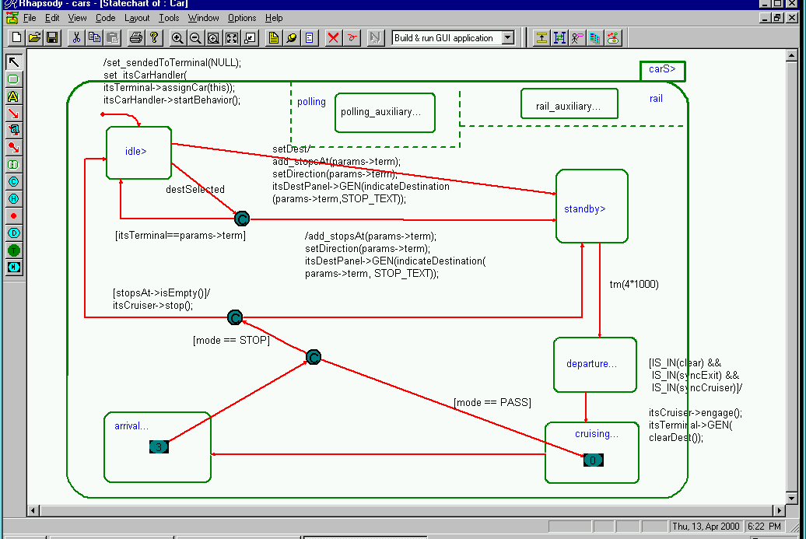
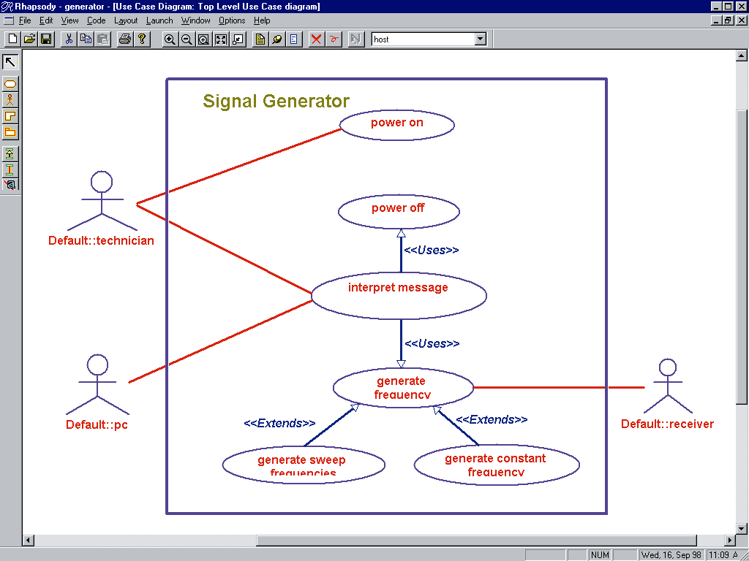
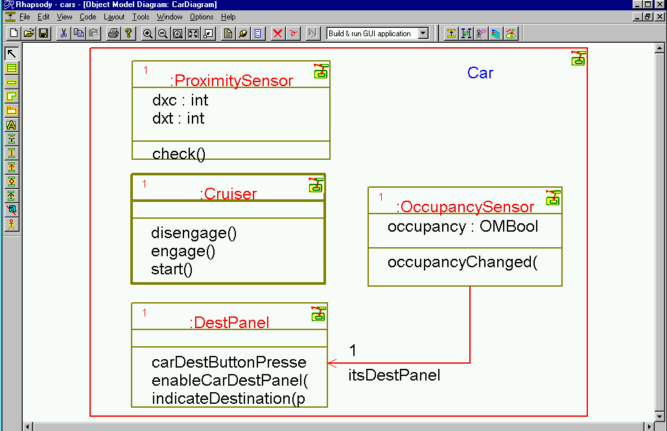
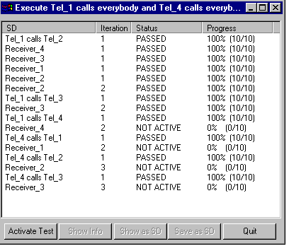
Automated Scenario-Based Testing
Specification of test inputs
Requirements
Sequence-Diagrams
as test vectors
Stimulate...
Scenario-
based
Test
Execution
Environment
...Monitor
% Completion
Pass
Fail

Slide 11
Automated Requirements-Based Testing
Capturing of scenarios during execution
Conversion of requirements scenarios to test vectors
Application of test vectors to system
Gathering of pass/fail statistics
Identification of points of failure
You want to construct, execute and summarize scenario-based tests integrated with your model

Slide 12
Formal Methods
Automatic SB testing is based on the recent work done in formal methods
Formal methods mathematically analyze models to determine adherence to rules, such as
  No unreachable states or conditions
  No constraint violations
  Liveness criteria
FMs then construct tests to validate these checking rules are true

Slide 13
Scheduling Theory
Scheduling theory is not new, but it is becoming more mainstream
The UML Profile for Schedulability, Performance and Time defines a standard set of tags and stereotypes that can be read by analytical tools, identifying
  Bandwidth and performance problems
  Scheduling and resource problems
The results of the analysis can feedback and update the model

Slide 14
Distribution
Real-Time systems have long been small, isolated platforms but that is no longer true
Most distributed embedded systems have been linked with proprietary custom special-purpose protocols and hardware
The drive is to use COTS protocols, communication media and diverse hardware
Solution – use middleware to isolate the application from detailed knowledge of data transport

Slide 15
Middleware
Middleware provides a platform-independent means for enabling the collaboration of architectural elements
Availability of ORBs for different platforms means that
  Existing apps can be maintained and ported even when hardware is obsoleted
  Legacy and foreign systems may be more easily connected
  Communication and collaboration issues are isolated and may be managed independently of domain IP

Slide 16
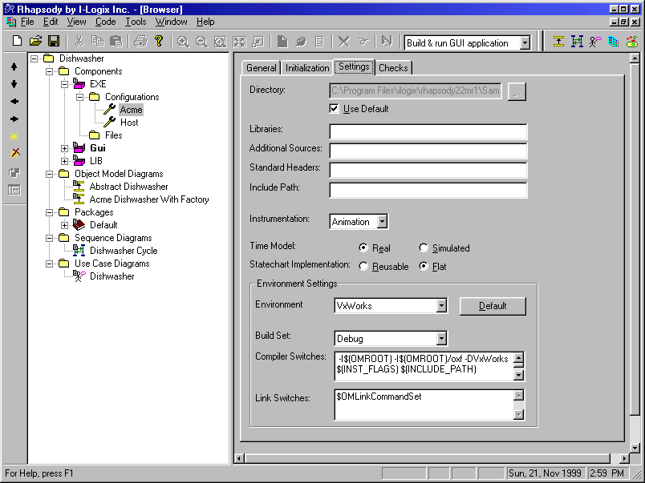
Real-Time Frameworks
Every application is 60-90% “housekeeping code” which is redeveloped every time we build a system
A framework is a partially completed application which you customize and specialize for your particular application project
Frameworks are employed via a combination of
  Specialization
  Extension
  Usage
  Execution Control
Application
specializes
extends
uses
executes

Slide 17

Processes
Test
Integration
And Test
Validation
Translation
Party!
Details
Requirements
Mechanisms
Architecture
Systems
Engineering
Design
Object
Analysis
Analysis

Slide 18

Waterfall Lifecycle
first
The waterfall lifecycle is
breadth first
Assumes each phase can be completed before the next starts
  Assume only minor errors will be made
Testing comes only at the end
second
Major scheduling points

Slide 19
What’s good about Waterfall?
Simple
Easy to plan
Tools are oriented around the approach

Slide 20
What’s the problem with Waterfall?
System is constructed using work that is presumed to be correct but not tested to be so
Testing comes late, so strategic defects are difficult and expensive to repair
  Requirements Defects
  Architectural Defects
Risks are identified and addressed late

Slide 21
Spiral Lifecycle
The spiral lifecycle is a depth first approach
A limited functional subset is developed, implemented and tested before adding more
Testing occurs early and often
second
first
Major scheduling points

Slide 22
What’s good about Spiral?
Testing comes early and often
System is constructed incrementally using pieces that are demonstrated to be correct
High risk things can be evaluated and tested early

Slide 23
What’s wrong with Spiral?
It’s newer, therefore scarier
Tools are not oriented towards scheduling
Requires more understanding to schedule
May require more work to integrate different disciplines, e.g.
  Mechanical
  Electronic
  Chemical
  Software

Slide 24
Semispiral Lifecycle
first
Used for some of the benefits of the spiral lifecycle but when the full spiral doesn’t apply well
  Large multi-team projects
  Significant co-design
  Funding for only one phase
Analysis is done as in waterfall
Design is done as in spiral
second

Slide 25
It’s all about early risk reduction
Waterfall lifecycle
Time to reprint your resume
Semispiral lifecycle
Risk
Spiral lifecycle
Time

Slide 26

What’s Cooking with UML

Slide 27
What’s Cooking for UML
UML 1.5
  Integration with Action Semantics
UML 2.0
  Infrastructure
  Superstructure
  OCL
  Diagram Interchange
UML Profile for Schedulability, Performance and Time
  Voted in
  FTF has started work

Slide 28
What’s Cooking for UML
UML Profile for Testing
  Work underway
Systems Engineering
  RFI released
  Expect to release an RFP
Fault Tolerance and QoS Framework
  RFP Released

Slide 29
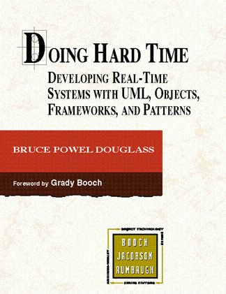
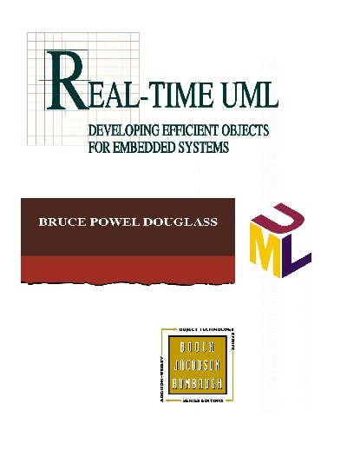
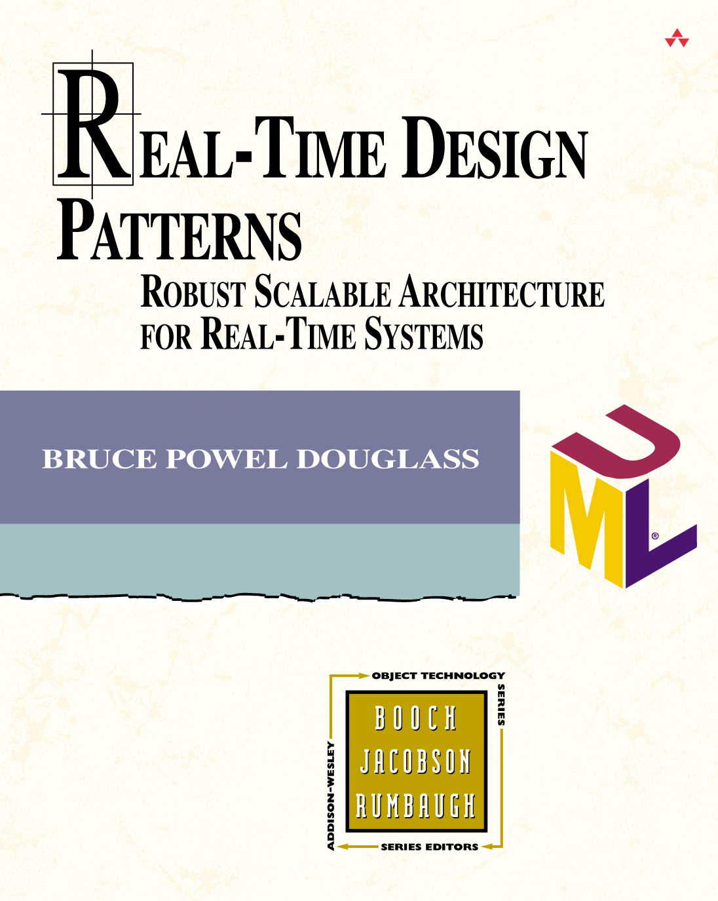
Some References of Interest

